Slide 1
CSC 101 Applied Physics Spring 2023

Slide 2
Ch-3 Equilibrium of a Particle
Equilibrium means, that the particle/object is at REST
Similarly, if the particle/object is moving with constant VELOCITY, and there is no acceleration, so it is in equilibrium
we are dealing with FORCE Vectors, and these vectors can be:
In any one plane:
that is XY- plane (No force vector in Z-axis)
that is in XZ- plane (no force vector in Y- axis)
that is in YZ-plane (No force vector in X-axis)

Slide 3
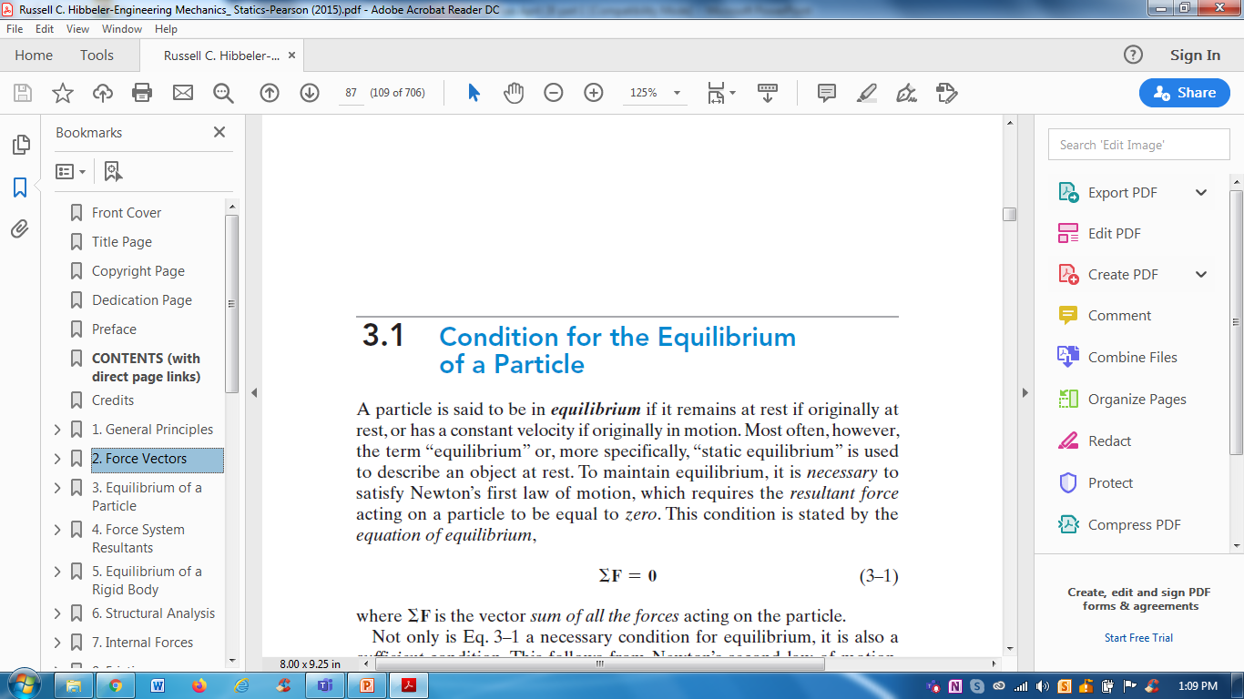
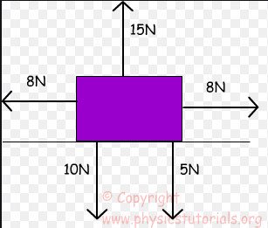
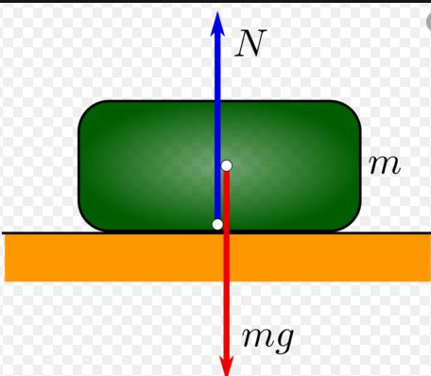
Ch-3 Equilibrium of a Particle
The condition of equilibrium is that sum of all forces acting on particle or object is zero

Slide 4
Ch-3 Equilibrium of a Particle
3.2 Free Body Diagram (FBD)
Meaning of Free-Body Diagram (FBD):-
It is a diagram
It is a graphical representation
It is an illustration (drawing)
And This diagram shows all the forces acting on an object/body
We can also say, that object is ISOLATED / FREE from all the forces acting on that object

Slide 5
Ch-3 Equilibrium of a Particle
3.2 Free Body Diagram (FBD)
Free-Body Diagram (FBD):-
In this diagram, some forces would be known (magnitude, direction)
It means, the magnitude and direction of forces is given
Some forces would be unknown (magnitude and direction is not given)
So to satisfy the condition for equilibrium, the sum of all forces; known and unknown must be ZERO

Slide 6
Ch-3 Equilibrium of a Particle
Diagram of an Object with some forces
In this diagram, all the forces have magnitude given
These forces also have direction (left, right, top, down)
There are no UNKNOWN force
This object is at REST, bcz sum of all forces is zero

Slide 7
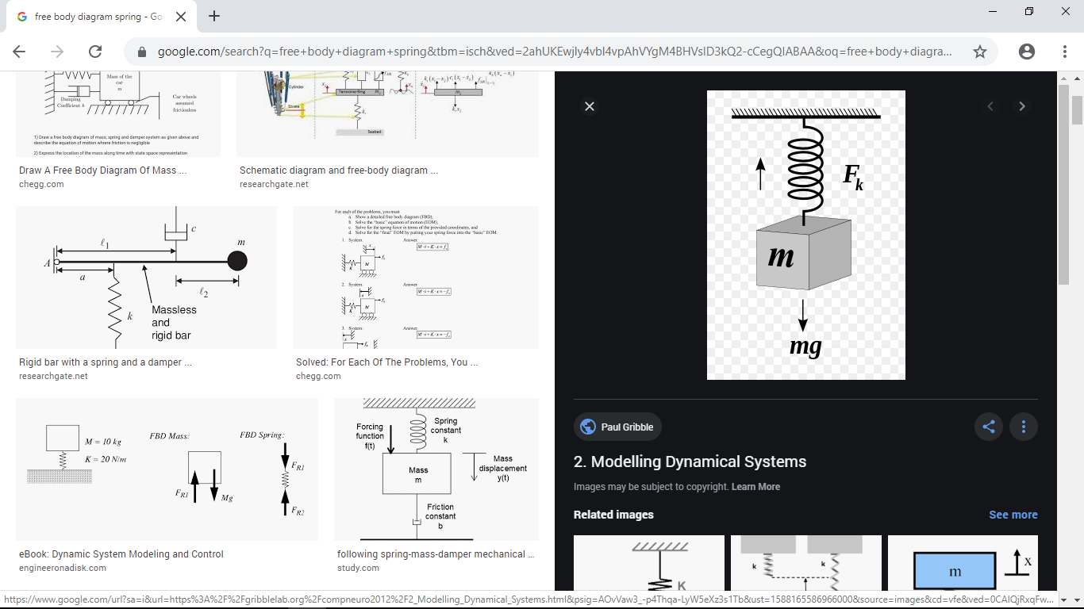
Ch-3 Equilibrium of a Particle
Now we have to observe the OBJECT/PARTICLE,
on which forces are applied/acting
It means, we also have to see that
position/location of object, that where
that object/particle is:
For example; in diagram, the mass m is tied with a spring

Slide 8
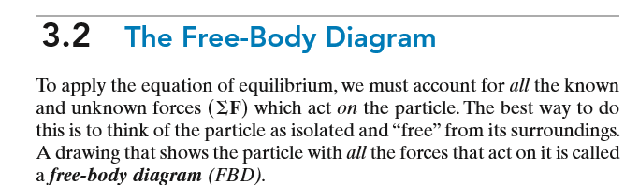
Ch-3 Equilibrium of a Particle
It means, the magnitude and direction of forces is given
Some forces would be unknown (magnitude and direction is not given)
So to satisfy the condition for equilibrium, the sum of all forces; known and unknown must be ZERO

Slide 9
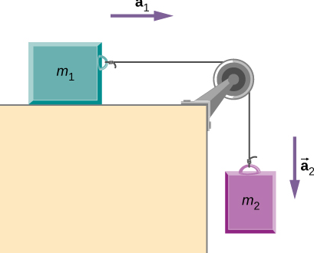
Ch-3 Equilibrium of a Particle
Two masses m1 and m2 are shown in the diagram here;
m1 is on table and m2 is hanging
These two masses are tied up with a pulley

Slide 10
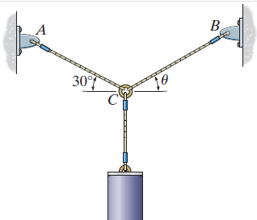
Ch-3 Equilibrium of a Particle
In the diagram shown here, one bucket is connected with a cable at the point C
The other two cables from the centre point C are attached to point A and point B
So we can say that the bucket is hanging and there are three cables, that are connected at point A and point B

Slide 11
Ch-3 Equilibrium of a Particle
Types of Connections: object is connected
There are three types of connections; as we saw in our three diagrams
SPRING (diagram A)
PULLEY (diagram B)
CABLE (diagram C)
A
B
C

Slide 12
Procedure to draw Free Body Diagram
Types of two forces that act upon the particle/object;
a) ACTIVE forces
b) REACTIVE forces
Active Forces: These forces are those by which the particle/object is in motion OR these forces tend to make the particle move
Reactive Forces: These forces the forces that appear due to the constraints on the particle/object OR such forces tend to stop the movement of the particle/object

Slide 13
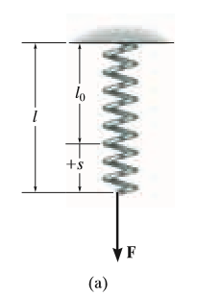
Ch-3 Equilibrium of a Particle
Types of Connections: object is connected
There are three types of connections; as we saw in our three diagrams
SPRING (diagram a)

Slide 14
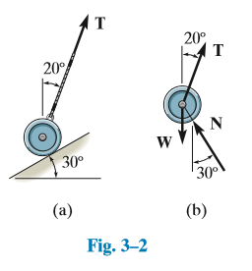
Ch-3 Equilibrium of a Particle
Types of Connections: object is connected
There are three types of connections; as we saw in our three diagrams
CABLE (diagram a, b of Fig. 3-2)

Slide 15
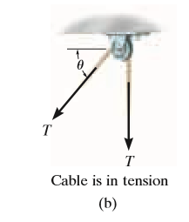
Ch-3 Equilibrium of a Particle
Types of Connections: object is connected
There are three types of connections; as we saw in our three diagrams
PULLEY (diagram b)

Slide 16
Procedure to draw Free Body Diagram
Procedure/Steps to obtain/draw a Free Body Diagram (FBD):
There are three steps, that are followed when we need to draw a Free-Body Diagram, these are given below:
Draw Outlined Shape
2) Show all the Forces
3) Identify each force

Slide 17
Procedure to draw Free Body Diagram
Procedure/Steps to obtain/draw a Free Body Diagram (FBD):
Draw Outlined Shape;
It means, we need to draw an outline such that the particle/object is ISOLATED/FREE from its surroundings (forces acting)
2) Show all the Forces;
We need to indicate all the forces acting upon the particle/object
Now there are two types of forces that acting upon the particle;
a) ACTIVE forces b) REACTIVE forces

Slide 18
Procedure to draw Free Body Diagram
Procedure/Steps to obtain/draw a Free Body Diagram (FBD):
3) Identify Each Force;
We need to LABEL each force; it means that we need to label or represent each force with
Magnitude and Direction/angle
We can further say, that the diagram should be labelled with all the forces (active and reactive) having magnitude and direction

Slide 19
Ch-3 Equilibrium of a Particle
Important point::
However, the object should be ISOLATED/FREE or DETACHED from all the forces acting on the object; that diagram will be FBD
F₁
F₂
FREE-BODY DIAGRAM (FBD)

Slide 20
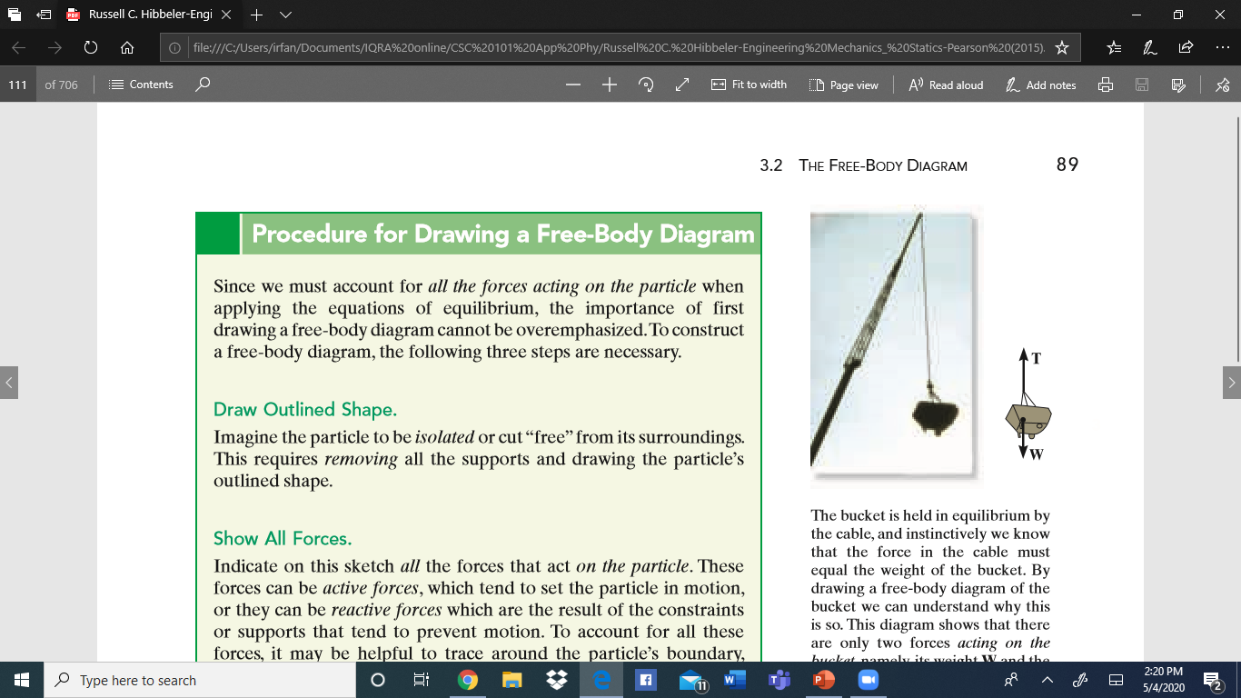
Procedure to draw Free Body Diagram
Example: 1
In the figure shown, we can see, that there are two forces, that are acting on the object;
Weight W
Tension T (stress in the cable)
F2
F1
Free-Body Diagram

Slide 21
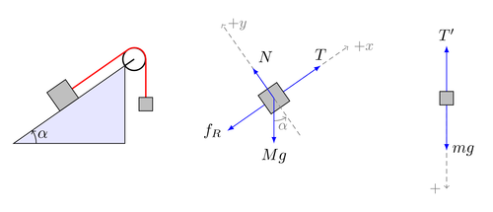
Examples of Free Body Diagram
Forces acting upon the object:
These four forces acting on the object are shown below:
Bigger mass m1
Smaller mass m2
Object is isolated / free from surroundings

Slide 22
Examples of Free Body Diagram
Forces acting upon the object:
There are four forces acting on the object mentioned below:
weight “Mg” in the downward direction
2) Friction “Fr” in the left-lower direction
3) Constrained force T in upper-right direction (+x)
4) Force “N” in the top-side direction (+y)

Slide 23
Procedure to draw Free Body Diagram
Step 1: Indicate/show all the forces
2) Show all the forces
3) Label all the forces
4
3
2
1
Four forces

Slide 24
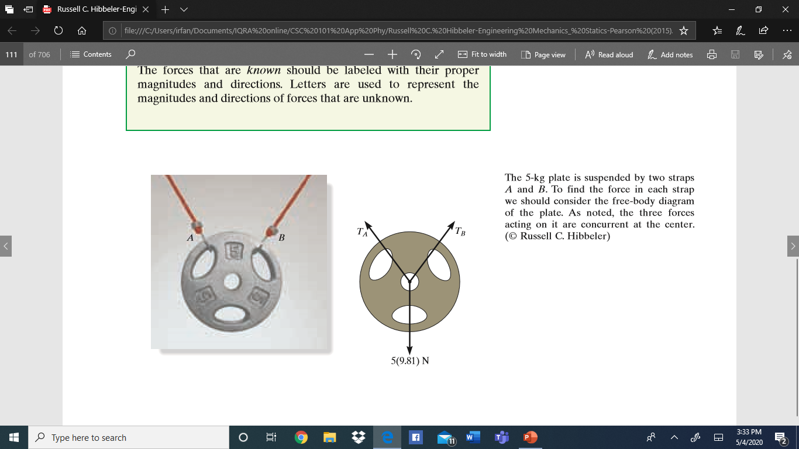
Procedure to draw Free Body Diagram
Procedure/Steps to obtain/draw a Free Body Diagram:
A plate is suspended by two straps; A and B

Slide 25
Procedure to draw Free Body Diagram
Procedure/Steps to obtain/draw a Free Body Diagram:
The plate is ISOLATED / FREE from the surroundings

